Slide 1
Introduction to C programming
Algorithm and programming

Slide 2
Learning Objectives
At the end of this session, student will be able to:
LO-1 : explain kind of algorithms in problem solving
LO-2 : apply syntax and functions in C language in problem solving

Slide 3
Subtopics
Introduction
C Standard Library
C Structure
Comments
Characters
Identifiers
Keywords
C Library Example
Exercise

Slide 4
IntroductioN
HISTORY OF C
History of C:
  1967 → BCPL designed by Martin Richards for OS and compiler development.
  1970 → B created by Ken Thompson for early UNIX development at Bell Labs.
  1972 → C developed by Dennis Ritchie at Bell Labs, based on B.
  1989 → ANSI standardized C (ANSI C), later ISO adopted it as well.
  C11 (2011), C18 (2018) → Latest official standards, adding modern features and fixing bugs.
While many modern languages like Python, C++, and Java are widely used today, C remains a powerful language for algorithm and systems programming because it offers:
  High performance for speed-critical systems
  Portability across hardware platforms
  Low-level memory access and fine hardware control
  Efficiency in both time and space, ideal for optimizing algorithms

Slide 5
C STANDARD LIBRARY
C STANDARD LIBRARY
We write the program code in a file that contains the main C source code, typically with a .c (or .cpp for C++) extension. Example: main.c
When programming in C, we typically use the following building blocks:
  C Standard Library Functions
    <math.h> : Mathematical Functions
    <stdio.h> : Input and Output
    <stdlib.h> : Utility Functions
    <string.h> : String Functions
    <time.h> : Time and Date Functions
  User-Defined Functions
    Functions you create yourself
  Third-Party Functions
    Functions other people have created and made available to you

Slide 6
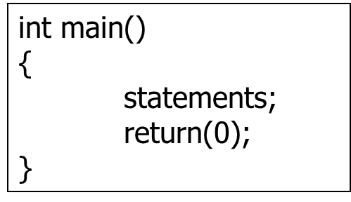
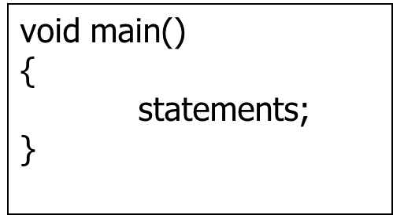
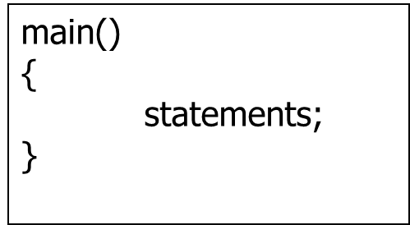
C structure
Main function
C is a structured programming language. It organizes code into functions.
Every C program must have a main() function, main() is where the program starts running
C is case sensitive:
  main is different from Main
  sum is different from Sum
Every command (statement) must end with a semicolon (;)

Slide 7
C structure
Main function structure
return(0); indicates a normal program termination without error.
By default, functions are assumed to return an integer (int) type if no return type is explicitly specified.
However, not all C compiler is familiar with all main function described above. Example:
  Using Turbo C 2.0 (DOS) and Microsoft Visual C++ (Windows) compilers: statements void main and int main compile successfully, but main may produce a warning.
  Using Dev-C++ (Windows) and gcc (Linux) compilers: statements main and int main compile successfully, but void main may produce a warning.

Slide 8
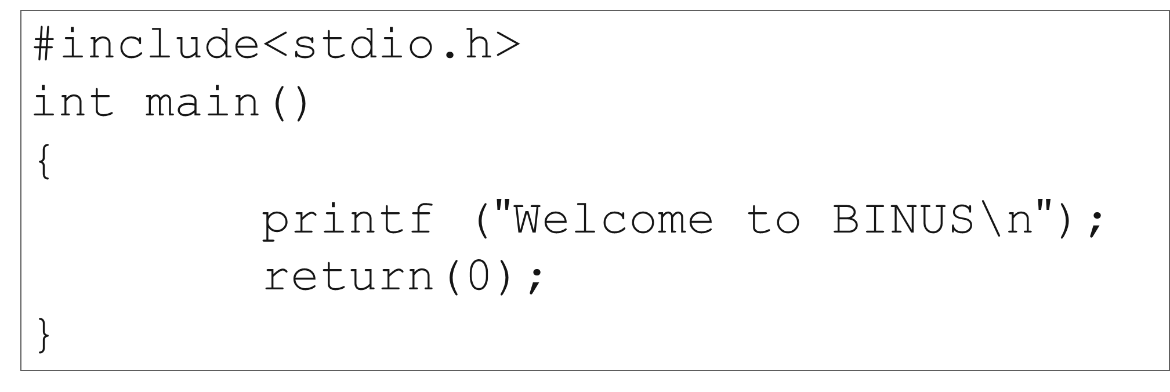
C structure
example
#include is a directive command to tell the computer to search for printf function prototype at header file stdio.h as well
Directive #include generally written at the beginning of a program
#include<stdio.h>
int main()
{
printf ($"$Welcome to BINUS\n$"$);
return(0);
}

Slide 9
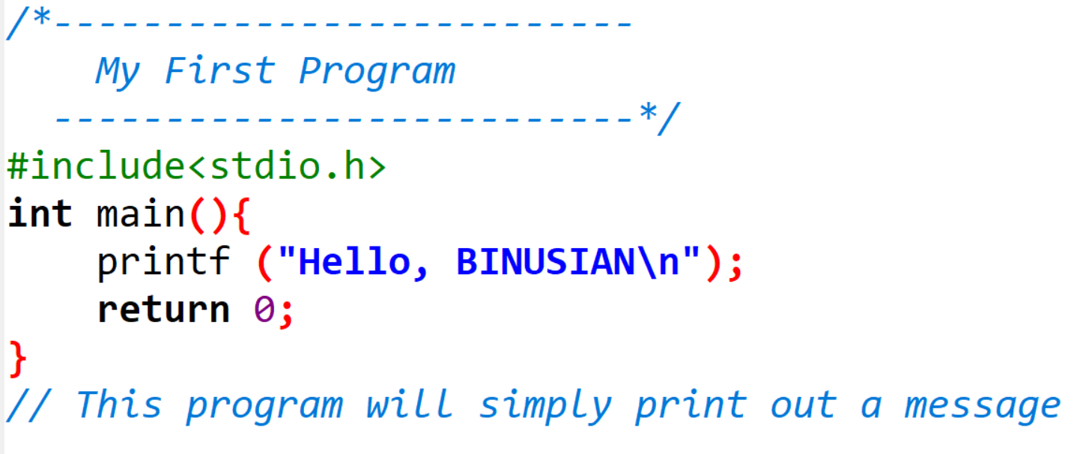
Comments
Comments
Comments is used for readability of the program
Not accounted as a command/statement by the compiler
Using /* */ for multi line comments
Using // at the beginning of line for one line comment

Slide 10
Character
Character
C program is written using ASCII character subset:
  →Capital letters A…Z
  →Lower Case a…z
  →Digit 0…9
  →Symbol ‘!’, ‘&’, ‘+’, ‘\’, ‘_’, etc.
ASCII (American Standard Code for Information Interchange)
  →http://www.asciitable.com/
To represent special characters that can't be typed directly or would be confusing to include directly we use escape characters.
\a bell, alert, system beep
\b back space
\t horizontal tab
\n new line, line feed
\v vertical tab
\r carriage return
\’ single quote
\” double quote
\\ backslash
\xdd hexadecimal notation
\ddd octal notation
Example of Escape Characters

Slide 11
Identifiers
Identifiers
Identifier is the name used to identify a variable, function, array, class, or any other user-defined element in a programming language.
Identifier rules in C:
  Started with a letter or underscore (_)
  Can include letters (A–Z, a–z), digits (0–9), and underscores (_).
  Case sensitive
  Maximum length is vary for every compiler
  Never use reserved word/keywords (such as: for, while, if, main)
Example:
  (v) name, x1, _total, cubic()
  (x) 1time, int

Slide 12
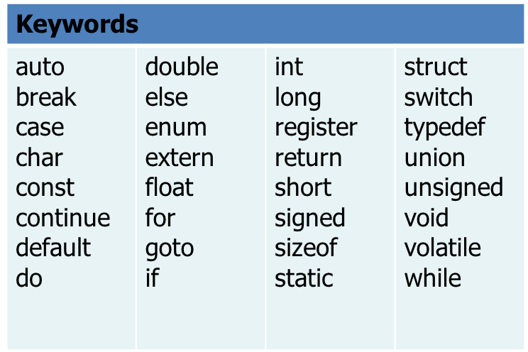
Keywords
Keywords
Keywords/reserved words are words that have special meaning to the C compiler.
Example

Slide 13
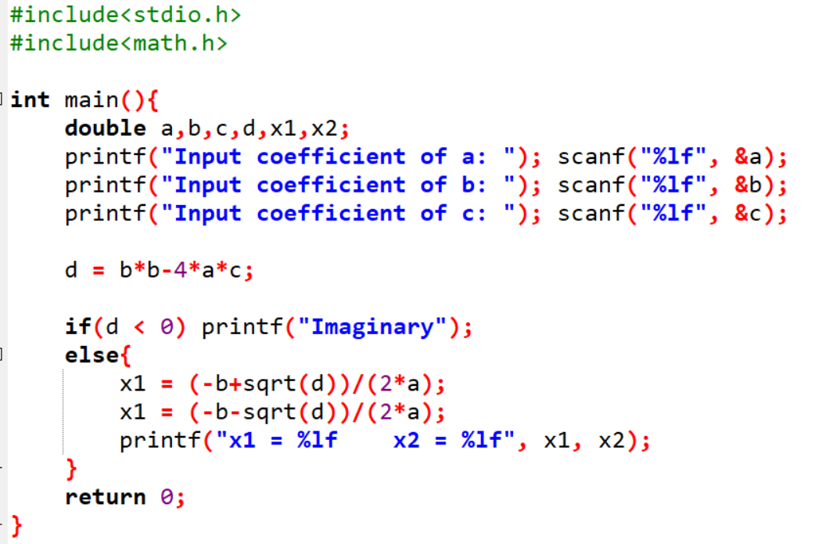
Keywords
Keywords
Some compilers will highlight keywords with distinct color, as seen from the figure below

Slide 14
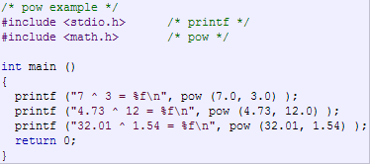

SAMPLE CODE
Math.h
Output:
math.h contains function declarations for a wide range of mathematical operations

Slide 15
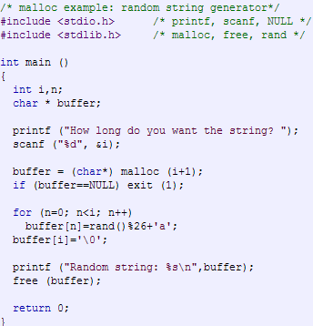
SAMPLE CODE
stdlib.h
stdlib.h is a standard C header file that provides functions for:
Memory allocation (malloc, free, etc)
Process control (exit, system, etc)
Conversions between strings and numbers (atoi, itoa, etc)
Random number generation (srand, rand)

Slide 16
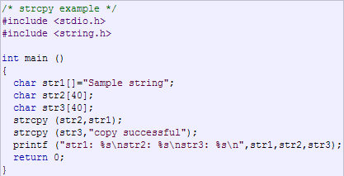

SAMPLE CODE
string.h
Output:
string.h provides functions to manipulate strings and memory blocks.

Slide 17
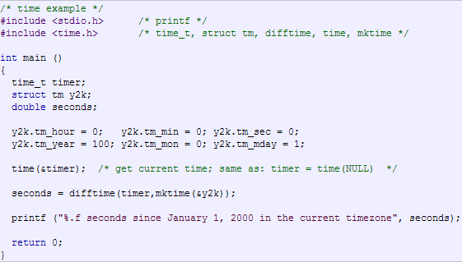
SAMPLE CODE
time.h
Output:
time.h provides functions and types for managing and manipulating time and date information.

Slide 18
EXERCISE
State whether each of the following statements is TRUE or FALSE. If it is FALSE, explain why.
Every C program begins execution at main function
Comments cause the computer to print the text enclosed between /* and */ on the screen when the program is executed
All variables must be defined before used
All variables must be given a type when they’re defined
C considers number and Number to be identical

Slide 19
SUMMARY
C is used because: high performance, portability and efficiency
C language is a structural programming language. It consists of functions
C program has one main function called main
C language is case sensitive.
Every statement in C language should be ended with a semi-colon (;)

Slide 20
REFRENCES
Paul Deitel & Harvey Deitel. (2021). C how to program. 09. Pearson Education. New York. ISBN: 9780137398393.
Jeri R. Hanly , Elliot B. Koffman. (2016). Problem Solving and Program Design in C. 08. ISBN: 9781292098814
Writing Your First C Program: http://aelinik.free.fr/c/ch02.htm
Data Types and Names in C: http://aelinik.free.fr/c/ch04.htm

